Slide 1
IND Discovery with Apache Spark
Team Name: Xcess Denied 2. GitHub repository link: https://github.com/steveoscar12/Big-Data-with-Apache-Spark.git

Slide 2

Slide Title: SINDy Algorithm with Apache Spark Objective:
Implementing the SINDy (Sparse Identification of Nonlinear Dynamics) algorithm.
Technology: Utilizing Apache Spark for finding INDs.

Slide 3
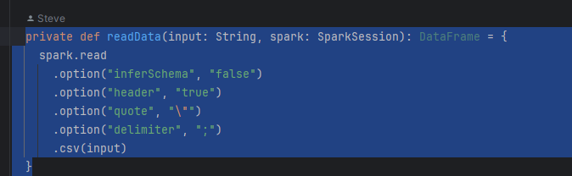
Data Loading:
input (String): Path to the target CSV file.
spark (SparkSession): SparkSession for Spark functionality.
Customized Configuration:
inferSchema set to "false": Disables automatic schema inference.
header set to "true": Treats the first row as headers for column identification.
quote set to \"": Specifies double quotes (") as the quote character.
delimiter set to ";": Uses semicolon (;) as the field delimiter.
CSV Reading Process:
Utilizes Spark's read method to process CSV data.
Configured options ensure specific reading behavior.
Read data from a specified CSV file into a Spark DataFrame.

Slide 4
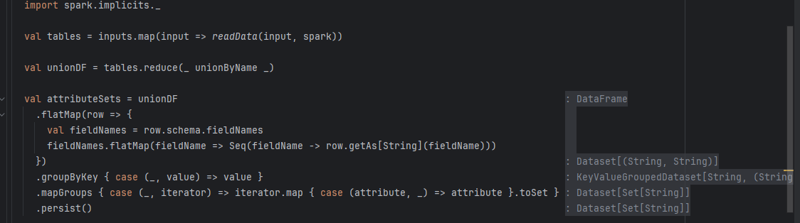
Extract the Data into DF
Loads tables from specified file paths into Spark DataFrames.
Combines DataFrames using unionByName to create a single DataFrame (unionDF).
Extracts attribute sets from each row of the combined DataFrame, grouping them by attribute values (attributeSets).

Slide 5
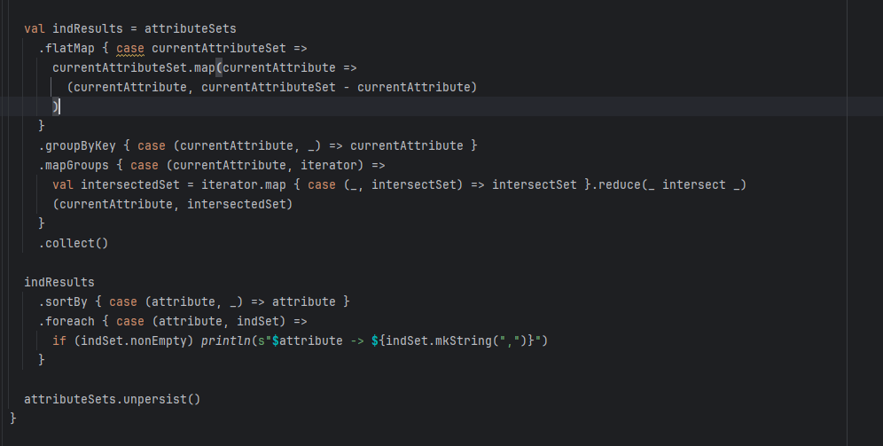
IND Discovery
Utilizes attribute sets to systematically discover INDs.
Generates pairs for each attribute and groups them by the current attribute.
Computes the intersection of sets within each group, representing the INDs.
Displays and prints the discovered INDs, sorted by attribute.
Releases persisted data for optimization.

Slide 6
Conclusion
The code efficiently extracts attribute sets from combined tables.
It systematically discovers Inclusion Dependencies (INDs) by finding intersecting attribute sets.
Results are sorted and printed, providing insights into the relationships within the data.

